Slide 1
http://qconsf2017intro.container.training/#372

Slide 2
Docker installation
Download the installation file for MAC-OSX.
Download the installation file for Windows.

Slide 3
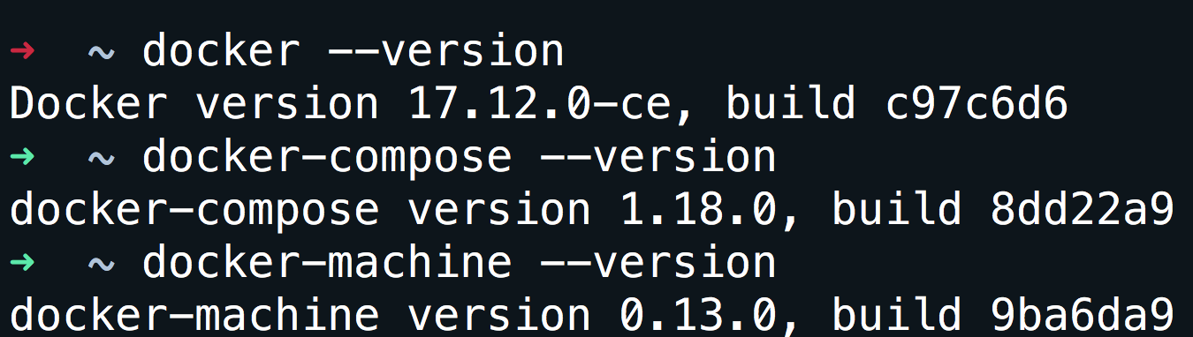
Verify installation
docker --version

Slide 4
Don’t want to install that is ok.
Open your browser and go to: https://labs.play-with-docker.com/

Slide 5
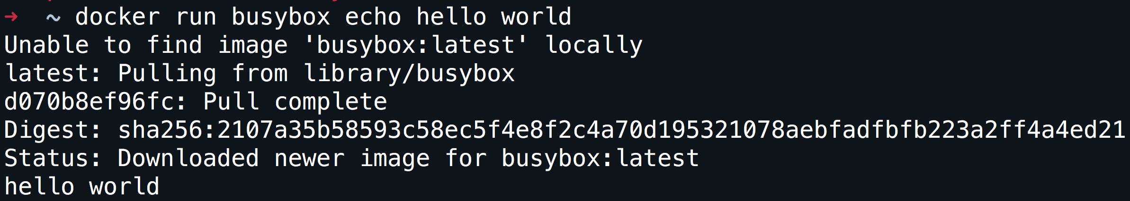
Run your first container
docker run busybox echo hello world

Slide 6
What did we just do
We download the smallest and simplest image from a repo.
We executed the command hello world.

Slide 7
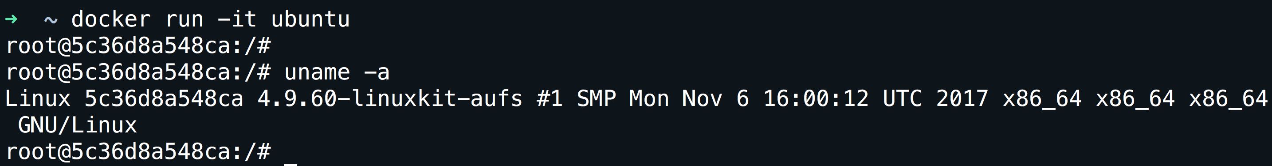
A more useful container
docker run -it ubuntu
-it is shorthand for -i -t.
-i tells Docker to connect us to the container's stdin.
-t tells Docker that we want a pseudo-terminal.

Slide 8
A few concepts
Images.
Volumes.
Network.
Containers.

Slide 9
Images
What is an image.
What is a layer.
The various image namespaces.
How to search and download images.
Image tags and when to use them.

Slide 10
What is an image
Image = files + metadata
Images are made of layers, conceptually stacked on top of each other.
Each layer can add, change, and remove files and/or metadata.
Images can share layers to optimize disk usage, transfer times, and memory use.
The images are a read-only filesystem.

Slide 11
Object-oriented programming
Images are conceptually similar to classes.
Layers are conceptually similar to inheritance.
Containers are conceptually similar to instances.

Slide 12
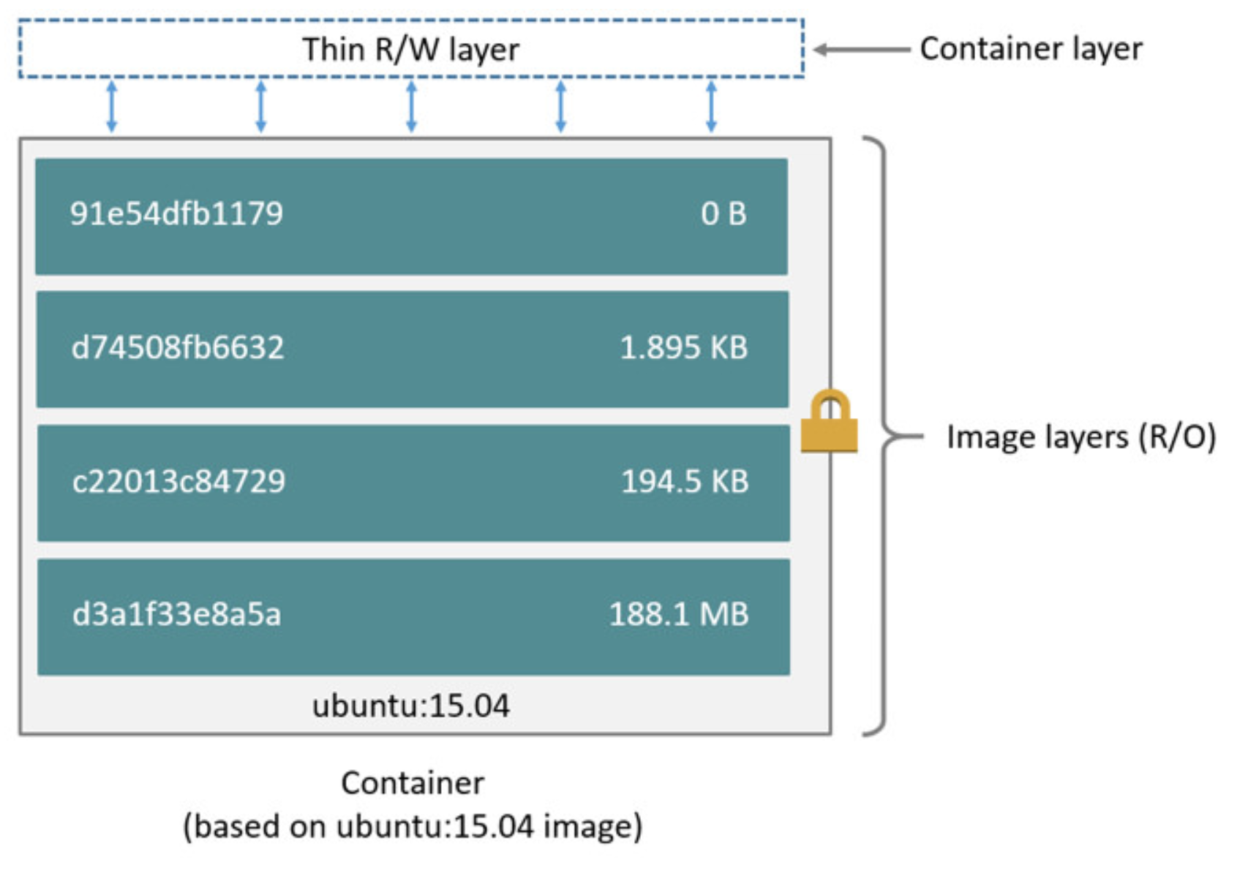
How an image looks like

Slide 13
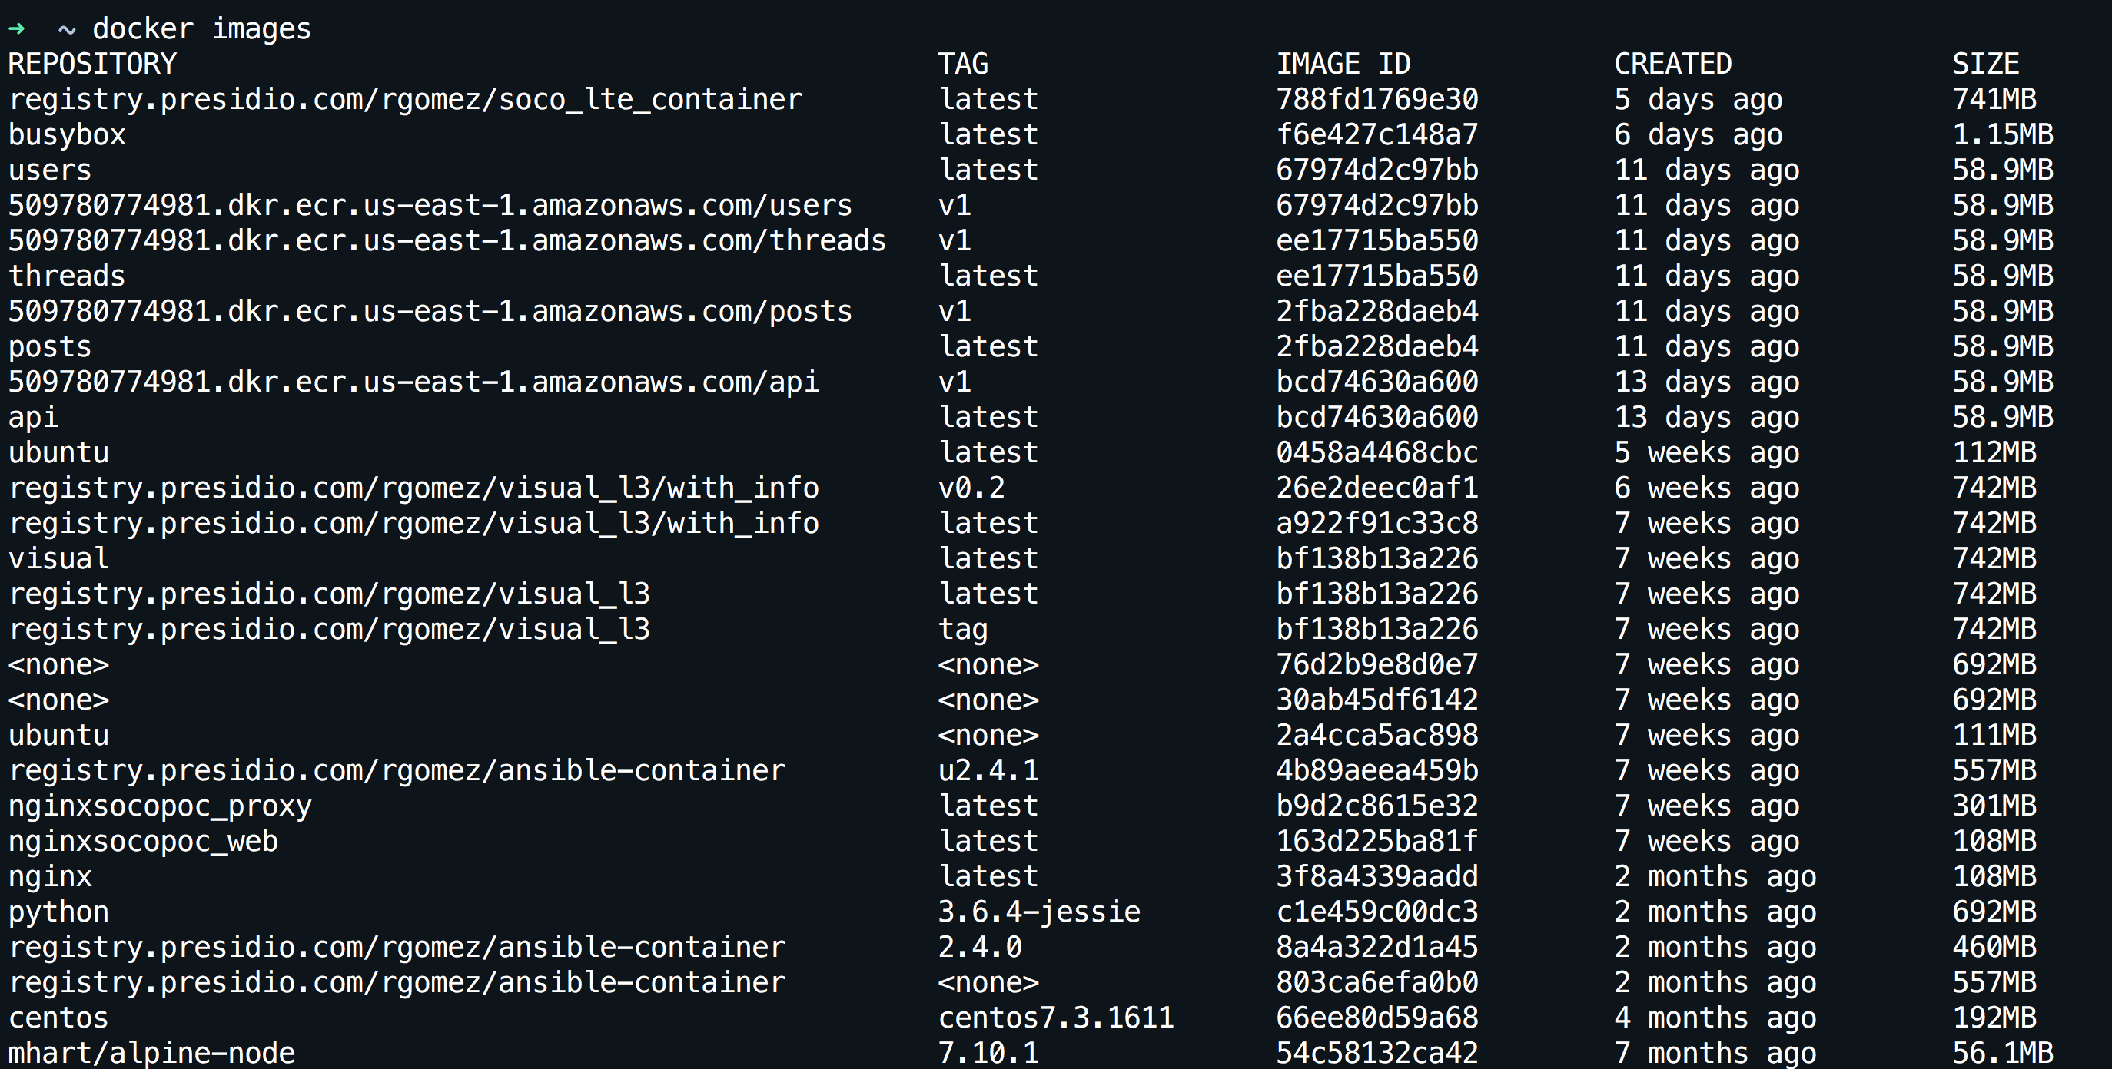
How can I see my images
docker images

Slide 14
Wait a minute…The image is read-only???!!!
We don't.
We create a new container from that image.
Then we make changes to that container.
When we are satisfied with those changes, we transform them into a new layer.
A new image is created by stacking the new layer on top of the old image.

Slide 15
How do we update an image
docker commit
Saves all the changes made to a container into a new layer.
Creates a new image (effectively a copy of the container).
docker build
Performs a repeatable build sequence.
This is the preferred method!

Slide 16
Dockerfile
vi dockerfile
Inside the file copy:
FROM ubuntu
RUN apt-get update
RUN apt-get install figlet
Save the file
docker build -t figlet .
docker images
docker run -ti figlet figlet HELLO

Slide 17
Extending Dockerfile
If the container is normally one process can we add that process into the image?
Using CMD and ENTRYPOINT.
These commands allow us to set the default command to run in a container.

Slide 18
New Dockefile with processes
To the previous dockerfile add at the end:
CMD figlet HELLO
Save the file.
docker build -t figlet-cmd .
docker run -ti figlet-cmd

Slide 19
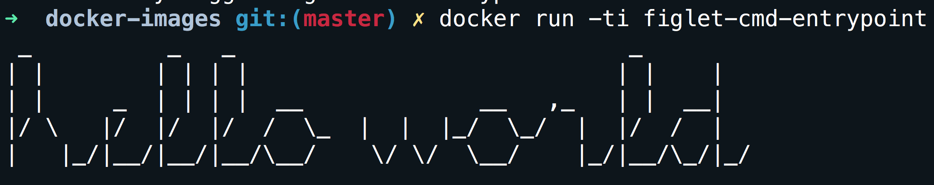
CMD vs ENTRYPOINT
CMD is the last resort to execute a process, if no process is specified during the container creation (docker run -it figlet bash) or no ENTRYPOINT is specified the CMD process is used.
CMD can complement ENTRYPOINT, if both are specified the ENTRYPOINT is the command while the CMD is the argument of the command. For example using:
ENTRYPOINT ["figlet", "-f", "script"]
CMD ["hello world"]
Is going to print:

Slide 20
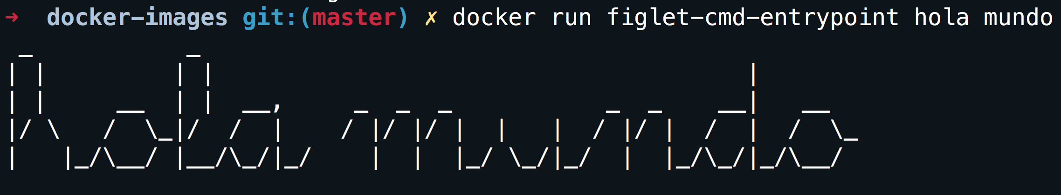
Overriding parameters
Executing docker run figlet hola mundo on the same image:

Slide 21
How do I copy my files
What good is a container if we can not copy our own files.
For the purpose the COPY SOURCE DESTINATION command exist.
A build context is needed
IMPORTANT: the build context is the directory containing the Dockerfile.

Slide 22
NGINX image
Create a new dockerfile-nginx with the following information:
FROM nginx:1.13-alpine
COPY nginx-conf/index.html /usr/share/nginx/html/
Create a new directory:
mkdir nginx-conf
Create an index:
echo "HELLO PRESIDIO" >> nginx-conf/index.html
Build the image and name the image mynginx.
docker build -f dockerfile-nginx -t mynginx .

Slide 23
Say HELLO PRESIDIO
Run the image:
docker run -d -P --name web1 my_nginx:latest
Find the port:
docker port web1
Go to your browser:
http://localhost:<PORT>

Slide 24
Don’t lose your container, share it.
Login to dockerhub
docker login
Use the correct tag in your container:
docker tag mynginx dockehub_username/test_nginx:v1
Push your container:
docker push dockehub_username/test_nginx:v1
Delete your image from your hard-drive.
docker image rm dockehub_username /test_nginx:v1
Verify the image is not longer present:
docker images
Download the image again:
docker pull dockehub_username /test_nginx:v1

Slide 25
Network in a container
The most common network technique we are going to see is port mapping (NAT).
The flag -P will tell the container that publish all ports defined on the image. This will be assigned to random ports.
The option -p host_port:docker_port, can be used to statically define a port mapping. Be aware of port conflicts.

Slide 26
Network drivers
bridge (default): each container will get an eth0 and a loopback. The default network should be 172.17.0.0/16 but it can be changed with –bip option.
none: only a loopback, no traffic in or out.
host: using the option --net host, the container will share the host network stack.
container: using the option --net container:id, the container will share with another container the network stack.

Slide 27
What network means to a container
Is network just a “virtual switch”??
Create a new network:
docker network create my_test
Create a container in the new network:
docker run -d -P --name web3 --net my_test nginx
Create another container:
docker run -ti --rm --name test_node --net my_test alpine ping web3
Did we configure name resolution?
docker run -ti --rm --name test_node --net my_test alpine cat /etc/resolv.conf
Who is 127.0.0.11?

Slide 28
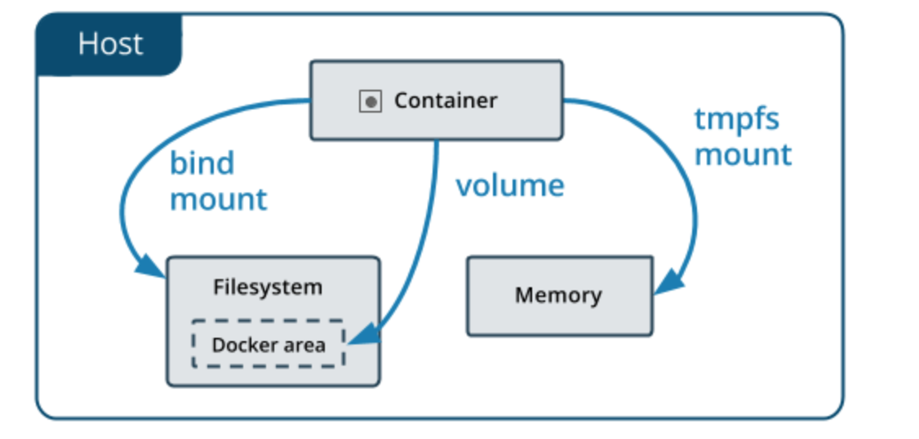
Storage for containers
There are tree storage types:
Volumes.
Binds.
Tmpfs.

Slide 29
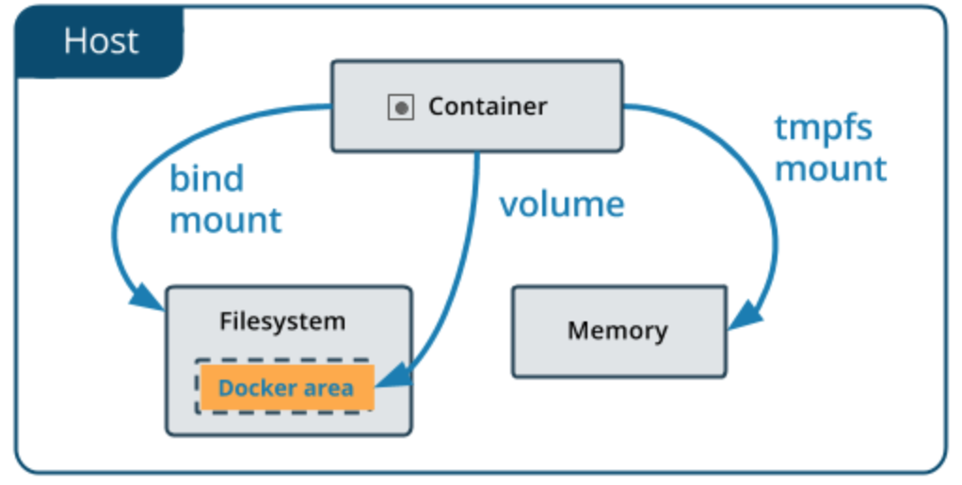
Containers and volumes
Volumes are specially designated directories within one or more containers that bypass the layered File System to provide persistent or shared data for Docker.
The volume exist Docker’s storage directory on the host machine.

Slide 30
Containers and volumes
Create a volume.
docker run -ti --rm -v new_vol --name test_volume alpine sh
Check the new volume inside the container.
df –h
Create a file on that volume.
echo 'this is a test' >> /new_vol/test.txt
Create another container with same volume.
docker run -it --rm --volumes-from test_volume --name test_volumne_1 alpine sh
Verify the file created in the other container exist.
cat /new_vol/test.txt

Slide 31
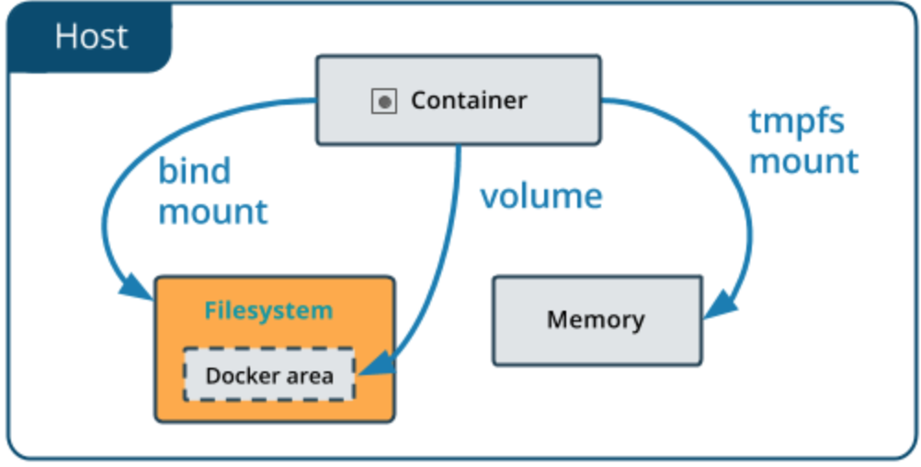
Containers and bindings
Bind mounts have limited functionality compared to volumes.
When you use a bind mount, a file or directory on the host machine is mounted into a container.

Slide 32
Containers and bindings
Create a directory.
mkdir my_bindings
Create a file inside the directory.
echo "bind test" >> my_bindings/test.txt
Run a container.
docker run -it --rm -v my_bindings/:/new_vol --name test_bind_1 alpine sh
Inside the container verify the file.
cat new_vol/test.txt
Edit the file.
echo "Another line" >> new_vol/test.txt
Exit the container.
Exit
Check the file again.
cat my_bindings/test.txt

Slide 33
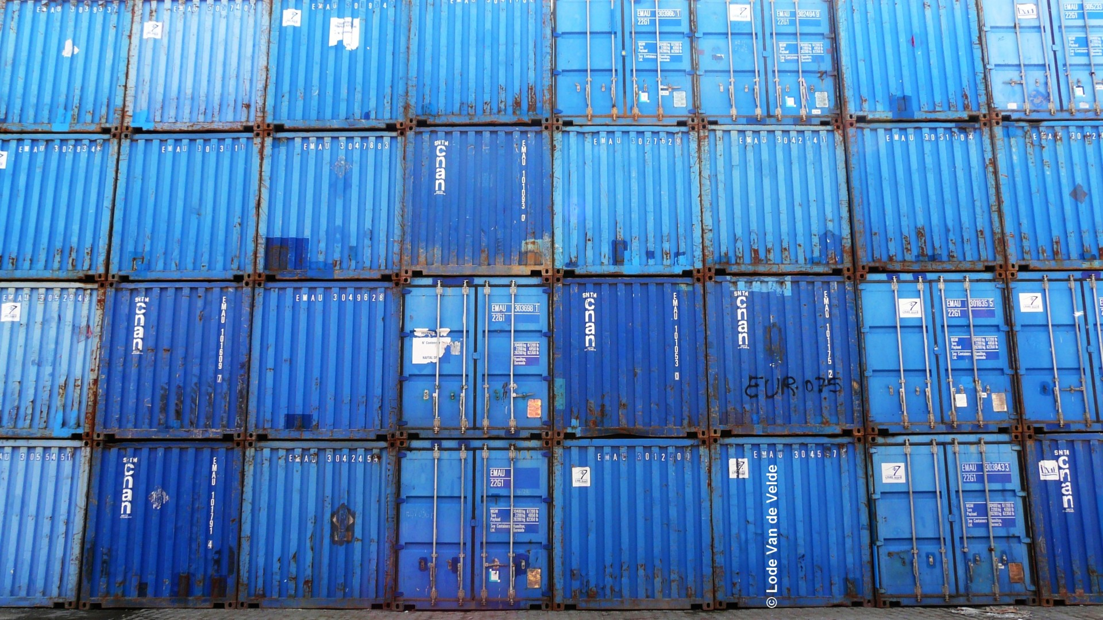

Slide 34
Why do we care about containers?
We can do everything that containers can do without them?
Why we cannot continue doing things in the same way?
Why do we need another layer?
Why…why…why???

Slide 35
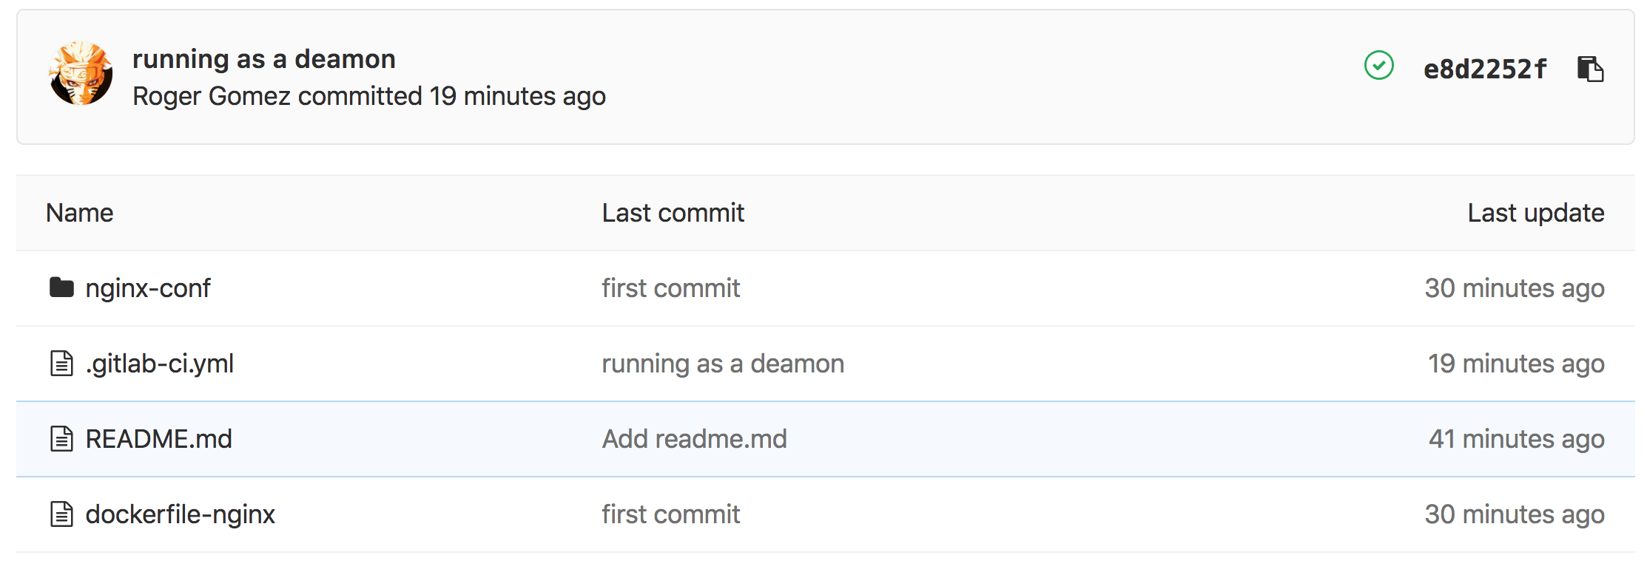
Developers love containers
cd/ci
CD/CI
cd/ci
Image
image
The container (AKA infrastructure) is part of the code

